Slide 1

Apex Institute of Technology
Department of Computer Science & Engineering
Bachelor of Engineering (Computer Science & Engineering)
Design and Analysis of Algorithms– (20CSH-282)
Prepared By: Mr. Vikas Kumar (E13657)
DISCOVER . LEARN . EMPOWER

Slide 2
Content
Algorithms for Find Min and Max
Example

Slide 3
Max-Min Problem
Max-Min problem is to find a maximum and minimum element from the given array.
We can effectively solve it using the divide-and-conquer approach.
In the traditional approach, the maximum and minimum elements can be found by comparing each element and updating Max and Min values as and when required.
This approach is simple but it does (n – 1) comparisons for finding the max and the same number of comparisons for finding the min.
It results in a total of 2(n – 1) comparisons. Using a divide-and-conquer approach, we can reduce the number of comparisons.

Slide 4
Divide and conquer approach for Max. Min problem
Divide and conquer approach for Max. Min problem works in three stages.
If a1 is the only element in the array, a1 is the maximum and minimum.
If the array contains only two elements a1 and a2, then the single comparison between the two elements can decide the minimum and maximum of them.
If there are more than two elements, the algorithm divides the array from the middle and creates two subproblems. Both subproblems are treated as an independent problems and the same recursive process is applied to them.
This division continues until the subproblem size becomes one or two.
After solving two subproblems, their minimum and maximum numbers are compared to build the solution to the large problem. This process continues in a bottom-up fashion to build the solution to a parent problem.

Slide 5
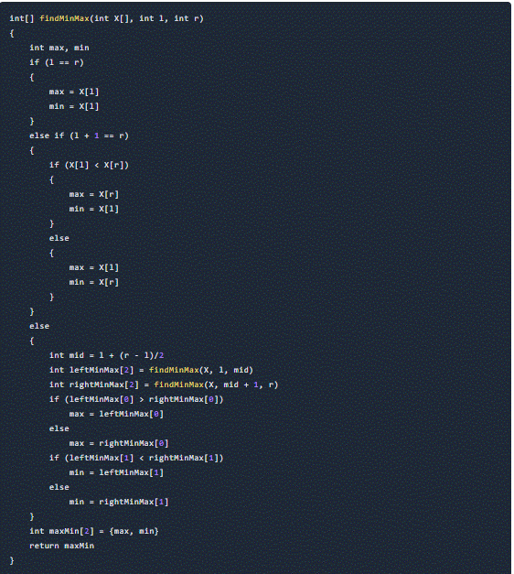
Algorithm for Max-Min Problem

Slide 6
Algorithm Analysis
The conventional algorithm takes 2(n – 1) comparisons in worst, best, and average cases.
Find_maxmin does two comparisons to determine the minimum and maximum element and creates two problems of size n/2, so the recurrence can be formulated as
T(n) = 0, if n = 1
T(n) = 1, if n = 2
T(n) = 2T(n/2) + 2, if n > 2
Let us solve this equation using an interactive approach.
T(n) = 2T(n/2) + 2 … (1)
By substituting n by (n / 2) in Equation (1)
T(n/2) = 2T(n/4) + 2
⇒ T(n) = 2(2T(n/4) + 2) + 2
= 4T(n/4) + 4 + 2 … (2)

Slide 7
Algorithm Analysis
By substituting n by n/4 in Equation (1),
T(n/4) = 2T(n/8) + 2
Substitute it in Equation (1),
T(n) = 4[2T(n/8) + 2] + 4 + 2
= 8T(n/8) + 8 + 4 + 2
= 2³ T(n/23) + 2³ + 2² + 2¹
Compared to the Naïve method, in the divide and conquer approach, the number of comparisons is less. However, using the asymptotic notation both of the approaches are represented by O(n).

Slide 8
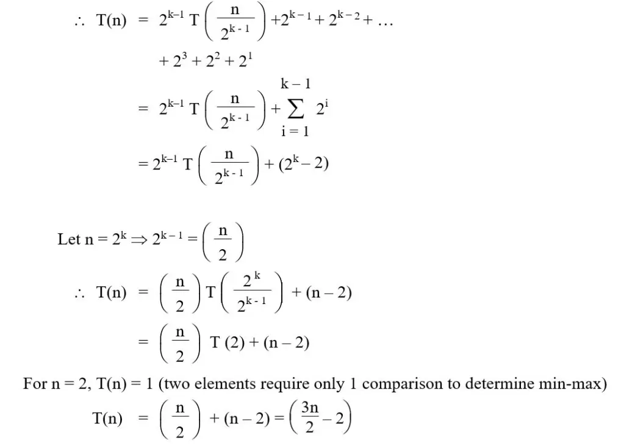
Algorithm Analysis

Slide 9
TASKS END OF LECTURE LEARNING (TELL):
Task 1:
Find max and min from the sequence <33, 11, 44, 55, 66, 22> using the divide and conquer approach.
Task 2:
How do we modify the above solutions when input values are repeated?
Task 3:
Why is space complexity O(logn) in the divide and conquer approach? Why are there two base cases? What would be the time complexity if we remove the base cases with array size 2?

Slide 10
References
Fundamentals of Computer Algorithms 2nd Edition (2008) by Horowitz, Sahni and Rajasekaran
Introduction to Algorithms 3rd Edition (2012) by Thomas H Cormen, Charles E Lieserson, Ronald

Slide 11
THANK YOU
For queries
Email: vikash.e13657@cumail.in

